Slide 1
Micron Backgrinding
Bench Testing Report
Application Team
7 July 2025
Rev 1

Slide 2
Executive Summary
A combination of 8ppm Aquafloc OC 1035, followed by 4ppm Anionic polymer Cure 950 was able to successfully significantly improve the settling of the sludge.
It is recommended to include two slow mix tanks for polymer mixing.
Cationic Polymer mixing tank
Anionic Polymer mixing tank
Cationic Polymer dosing station
Anionic Polymer dosing station
Effluent from the anionic polymer tank should go to the sludge thickening tank.
As a further improvement, Supernate from the sludge thickening tank can be sent to the TMF, Centrate from the centrifuge can be sent back to either the cationic, anionic, or sludge thickening tank.

Slide 3
Background
Micron Backgrinding wastewater project was having initial problems.
Excessive H₂ gas generation, leading to alarms on the portable gas detector
Excessive H₂ gas generation, leading to a hot and bubbling wet sludge
Dry solids that tends to create a silica dust that is airborne
Centrifuge had an effluent blockage and generated large solids within the centrifuge
Excessive solids in centrate, leading to choking in TMF
This plant is designed as an improvement of a conventional backgrinding WWTP and treats the backgrinding wastewater without the use of coagulants. The plant was designed with a centrifuge for solids removal due to continuous operation and minimal space available.

Slide 4
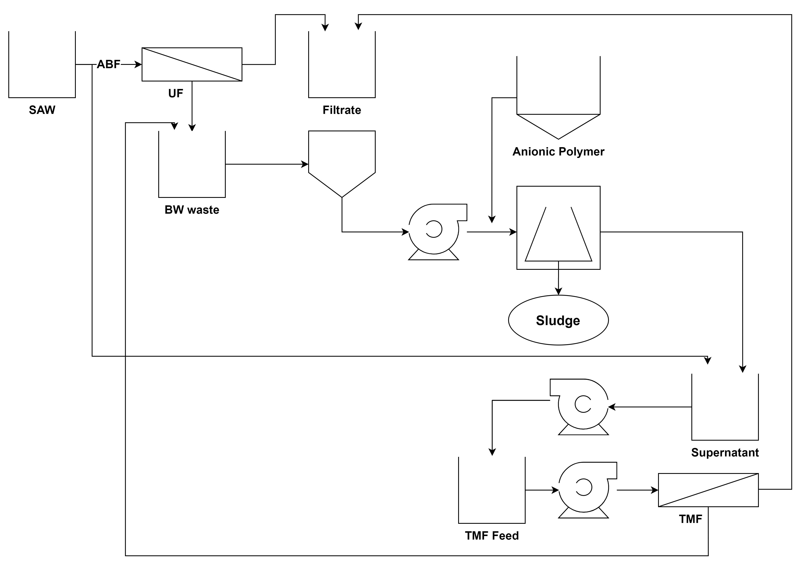
Block Flow Diagram

Slide 5
Process Design
To test different polymers that can improve the solids separation and for better solids dewatering.
Polymer dosage calculation
Jar test protocol

Slide 6
Polymer Dosage Calculation
Polymers in solid or liquid form were considered 100% purity.
100% polymers were diluted into 0.1% w/w concentration.
200mL of water sample was used for every jar test.
Polymer dosage was calculated.
Eg.
mL of 0.1% polymer | Dosage in ppm
2 | 10
4 | 20
6 | 30
8 | 40
10 | 50

Slide 7
Jar Test Protocol
Sample + different Cationic polymer (varied dosages)
Stir at 50/200 rpm for 30 min
After 30 min, add Anionic Polymer (Cure Flocculant) (4ppm)
Stir at 50 rpm for 15 min
After 15 min, allow sludge to settle for 15 min
Collect sludge for centrifuge test at 4,000 rpm for 5 min

Slide 8
Experiments

Slide 9
Test 1
Sample collected on 1 July 2025
Experiment conducted on 1 July 2025
Jar test parameters
Cationic - Stir at 200 rpm for 30 min
Anionic - Stir at 50 rpm for 15 min
ID | Sample, mL | Cationic, ppm | Anionic, ppm
1 | 200 | 0 | 4
2 | 200 | 10 | 4
3 | 200 | 20 | 4
4 | 200 | 30 | 4
5 | 200 | 40 | 4
6 | 200 | 50 | 4

Slide 10
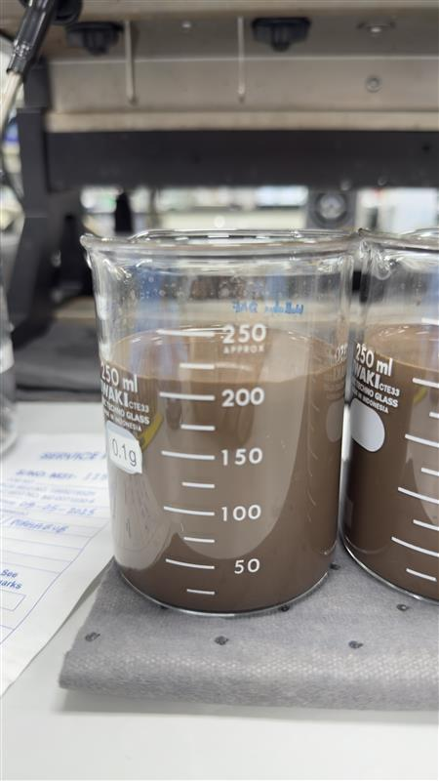
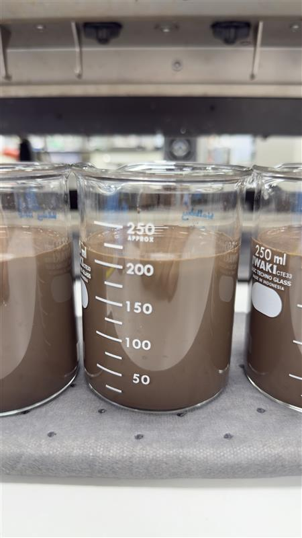
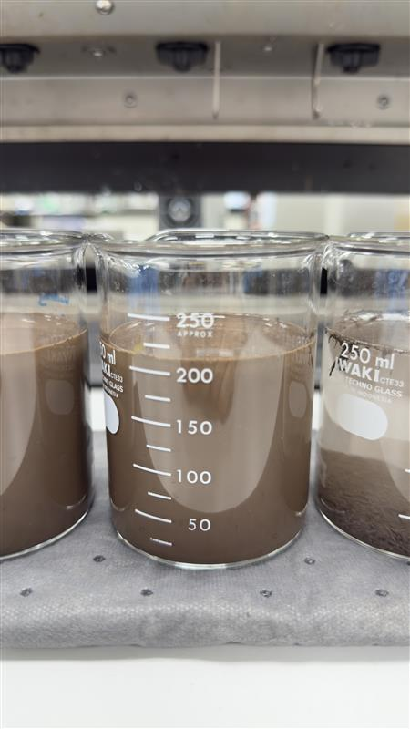
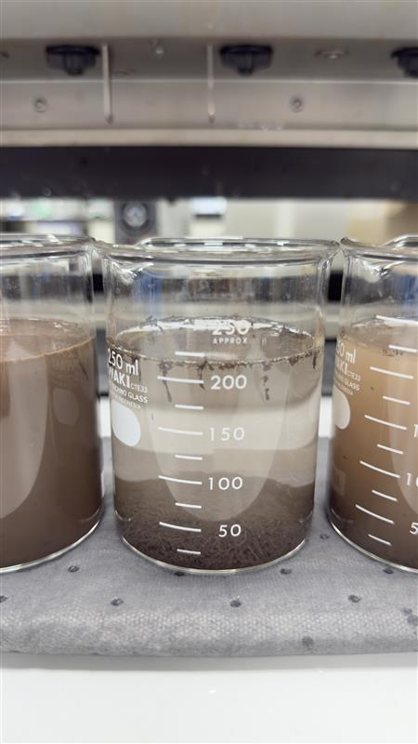
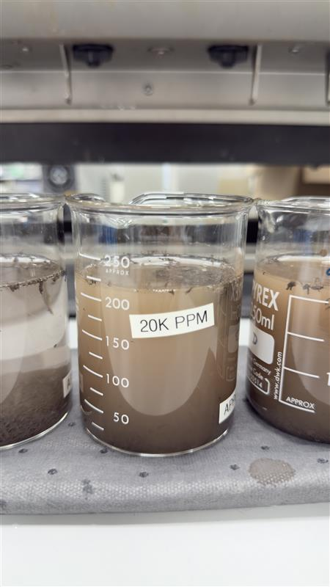
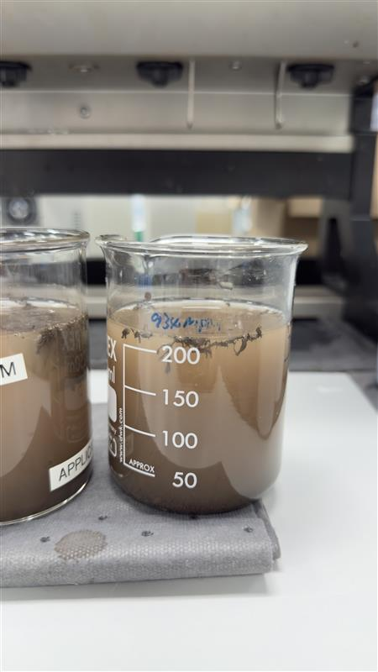
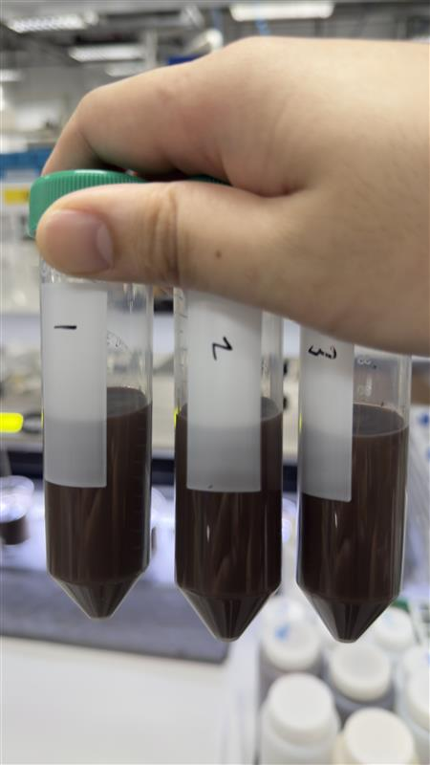
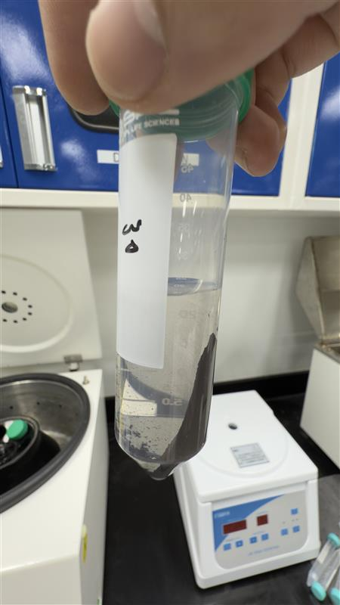
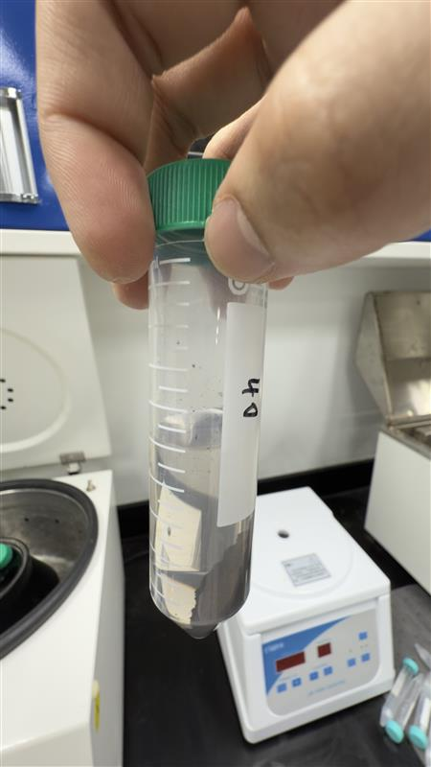
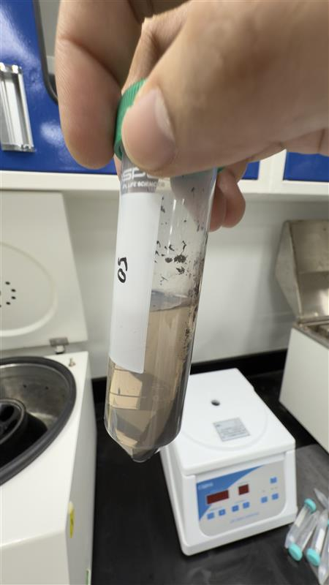
Results
Control
10ppm
20ppm
30ppm
40ppm
50ppm
Conclusion from this test
The solution does not settle and separate without chemical addition

Slide 11
Test 2
Sample collected on 3 July 2025
Experiment conducted on 3 July 2025
Jar test parameters
Cationic - Stir at 200 rpm for 30 min
Anionic - Stir at 50 rpm for 15 min
ID | Sample, mL | Cationic, ppm | Anionic, ppm
1 | 200 | 7 | 4
2 | 200 | 4 | 4
3 | 200 | 5 | 4
4 | 200 | 6 | 4
5 | 200 | 8 | 4
6 | 200 | 10 | 4

Slide 12
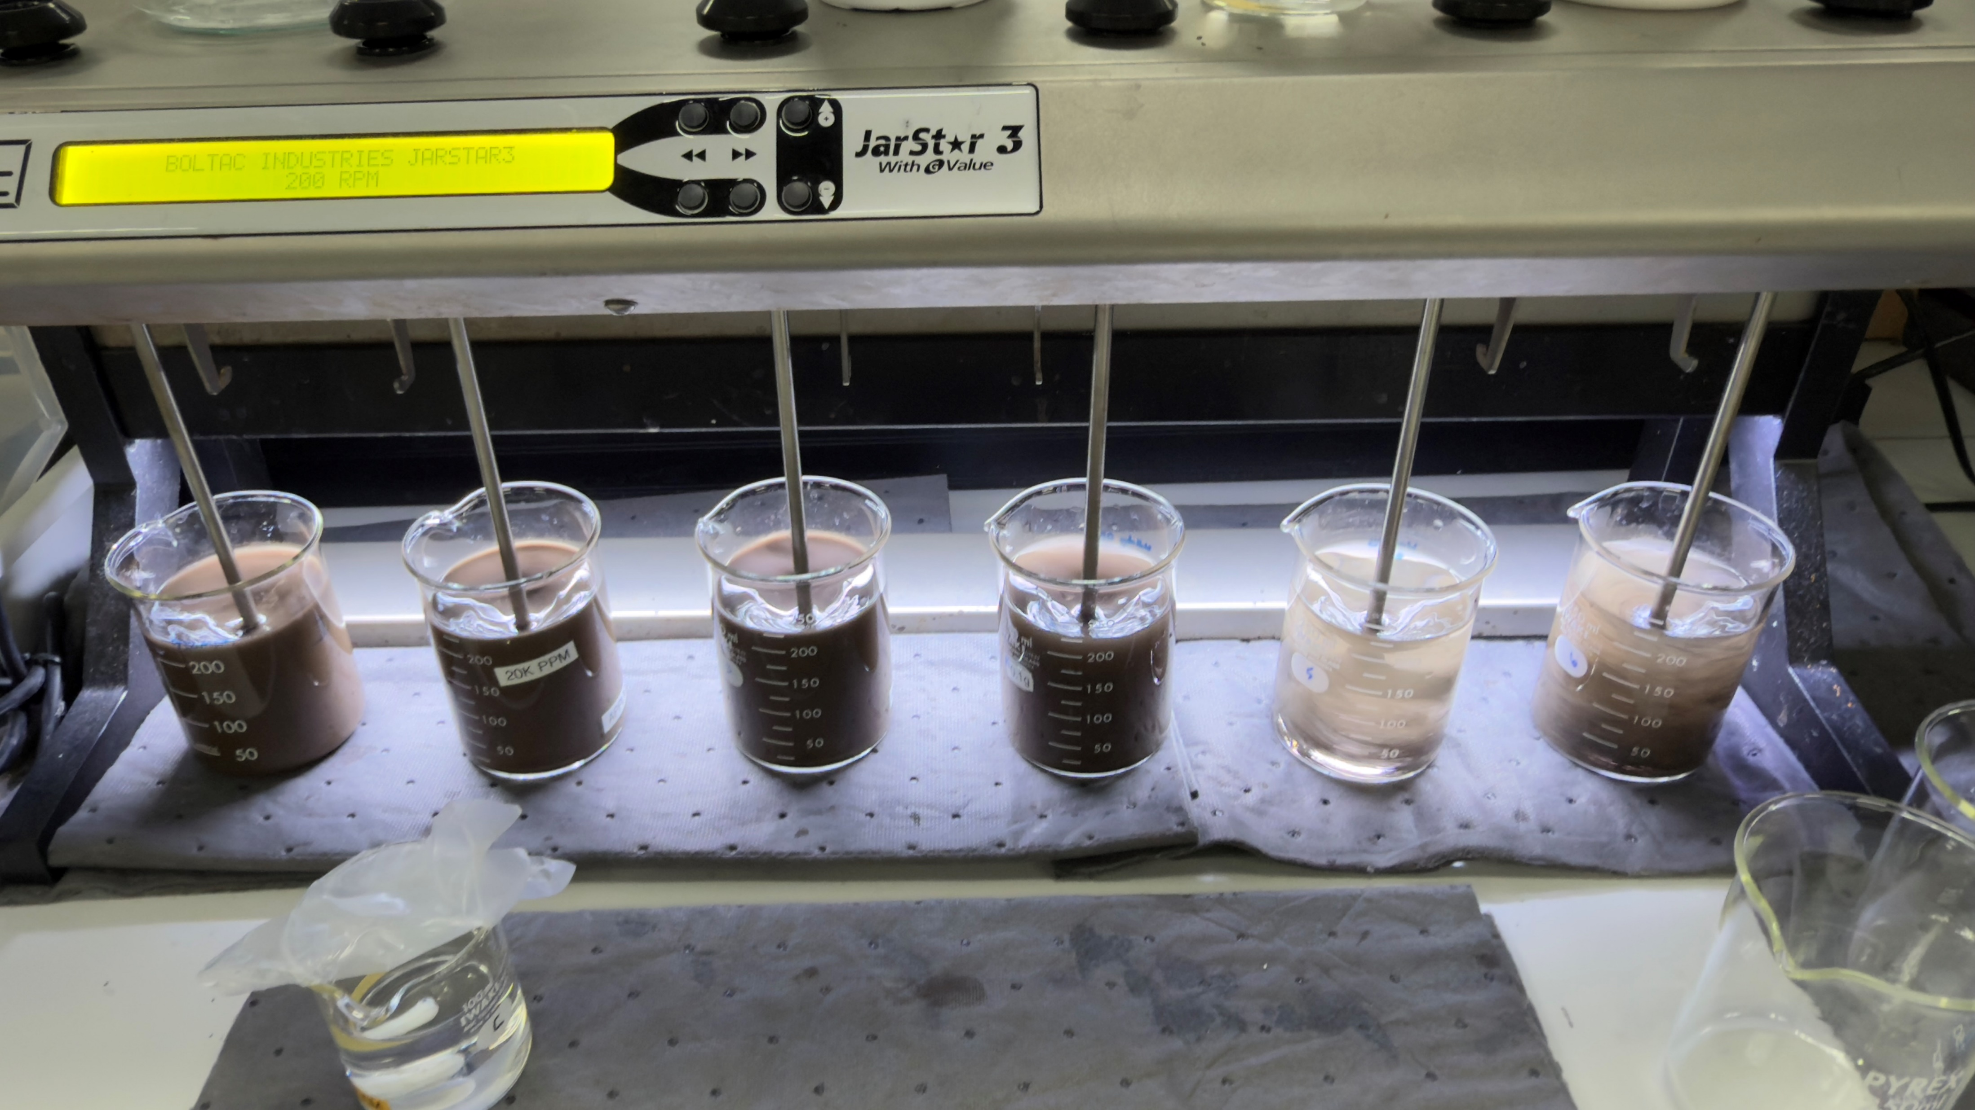
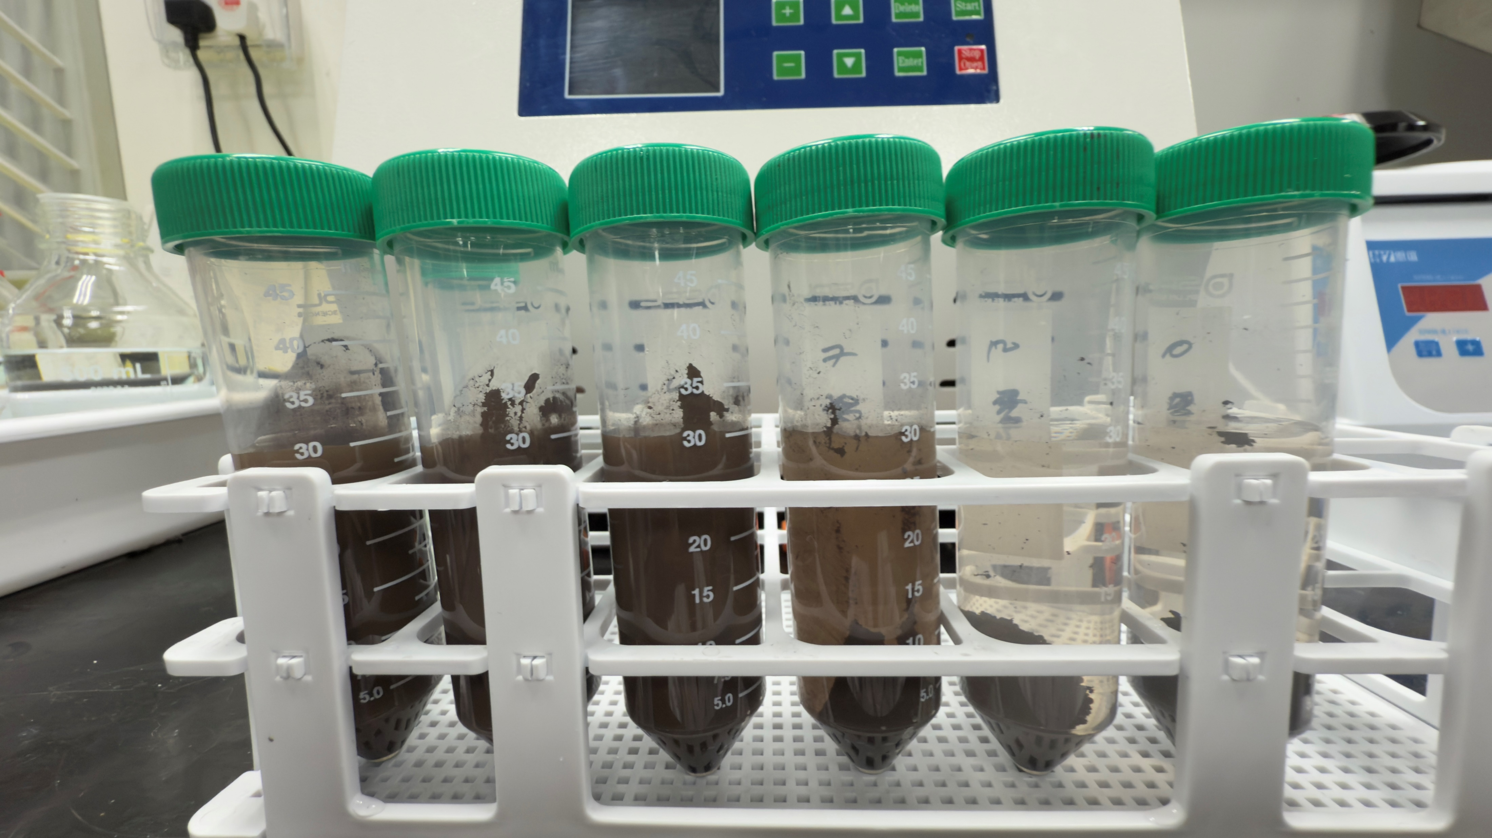
Results
7ppm
4ppm
5ppm
6ppm
8ppm
10ppm
Conclusion from this test
8ppm of Cationic polymer is promising

Slide 13
Test 3
Sample Collected on 3 July 2025
Experiment conducted on 4 July 2025
Jar test parameters
Cationic - Stir at 50 rpm for 30 min
Anionic - Stir at 50 rpm for 15 min
ID | Sample, mL | Cationic, ppm | Anionic, ppm
1 | 200 | 8 | 4
2 | 200 | 8 | 4

Slide 14
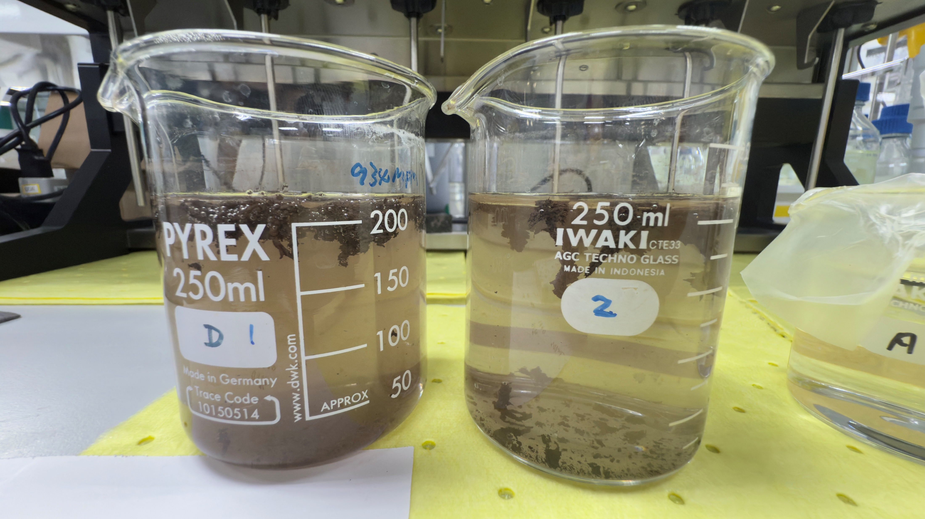
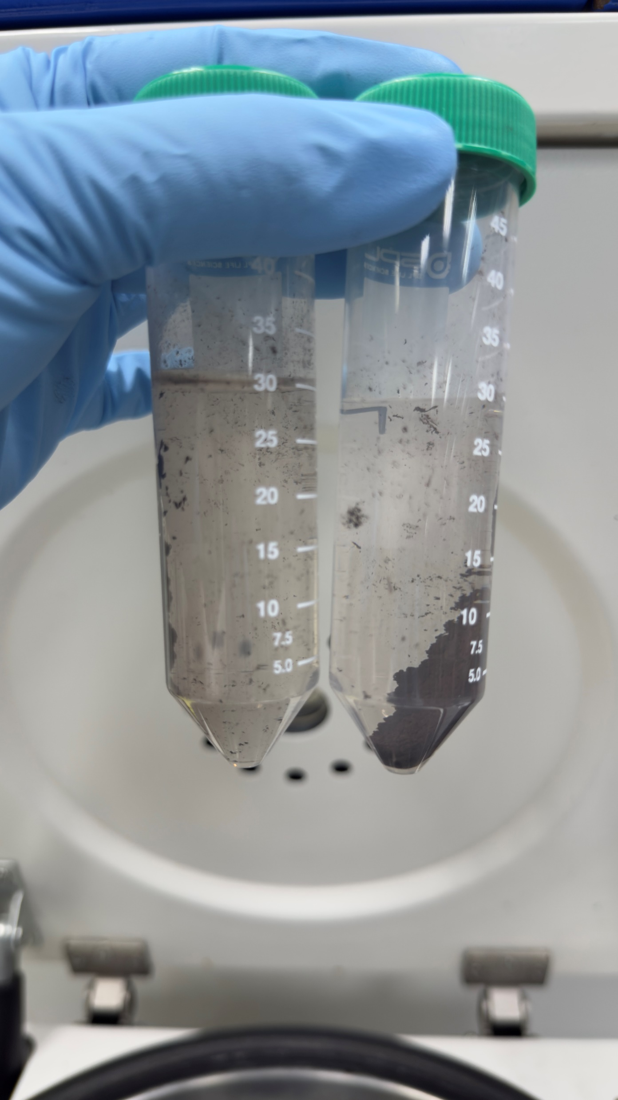
Results
200 rpm
50ppm
Conclusion from this test
Polymer should be added with a slow mixer around 50 rpm

Slide 15
Test 4
Sample Collected on 3 July 2025
Experiment conducted on 4 July 2025
Jar test parameters
Cationic - Stir at 50 rpm for 30 min
Anionic - Stir at 50 rpm for 15 min
ID | Sample, mL | Cationic, ppm | Anionic, ppm
1 | 200 | 8 | 4
Aquafloc OC 1035 | 200 | 8 | 4
Aquafloc OC 1035 | 200 | 10 | 4
Aquafloc OC 1035 | 200 | 20 | 4

Slide 16
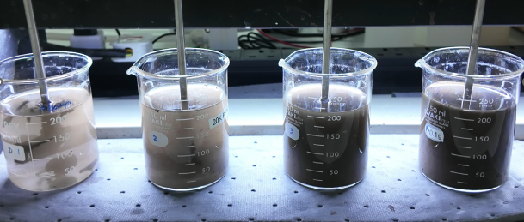
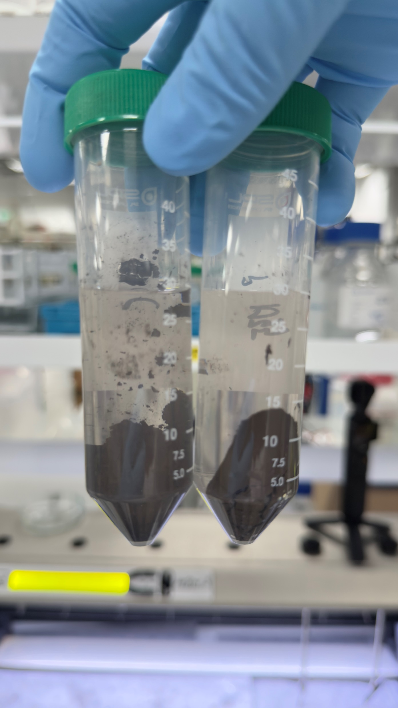
Results
Conclusion from this test
Adding an anionic polymer after cationic polymer was necessary

Slide 17
Test 5
Sample Collected on 3 July 2025
Experiment conducted on 4 July 2025
Jar test parameters
Cationic - Stir at 50 rpm for 30 min
Anionic - Stir at 50 rpm for 15 min
ID | Sample, mL | Cationic, ppm | Anionic, ppm
Aquafloc OC 1035 | 200 | 8 | 4
KIMIC 448030 | 200 | 8 | 4
KIMIC 446520 | 200 | 8 | 4
KIMIC 445510 | 200 | 8 | 4
Cationic | 200 | 8 | 4

Slide 18
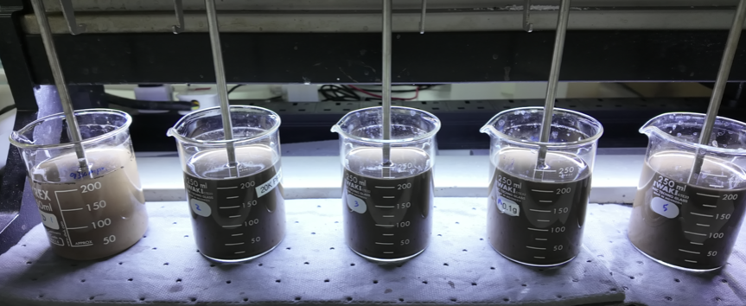
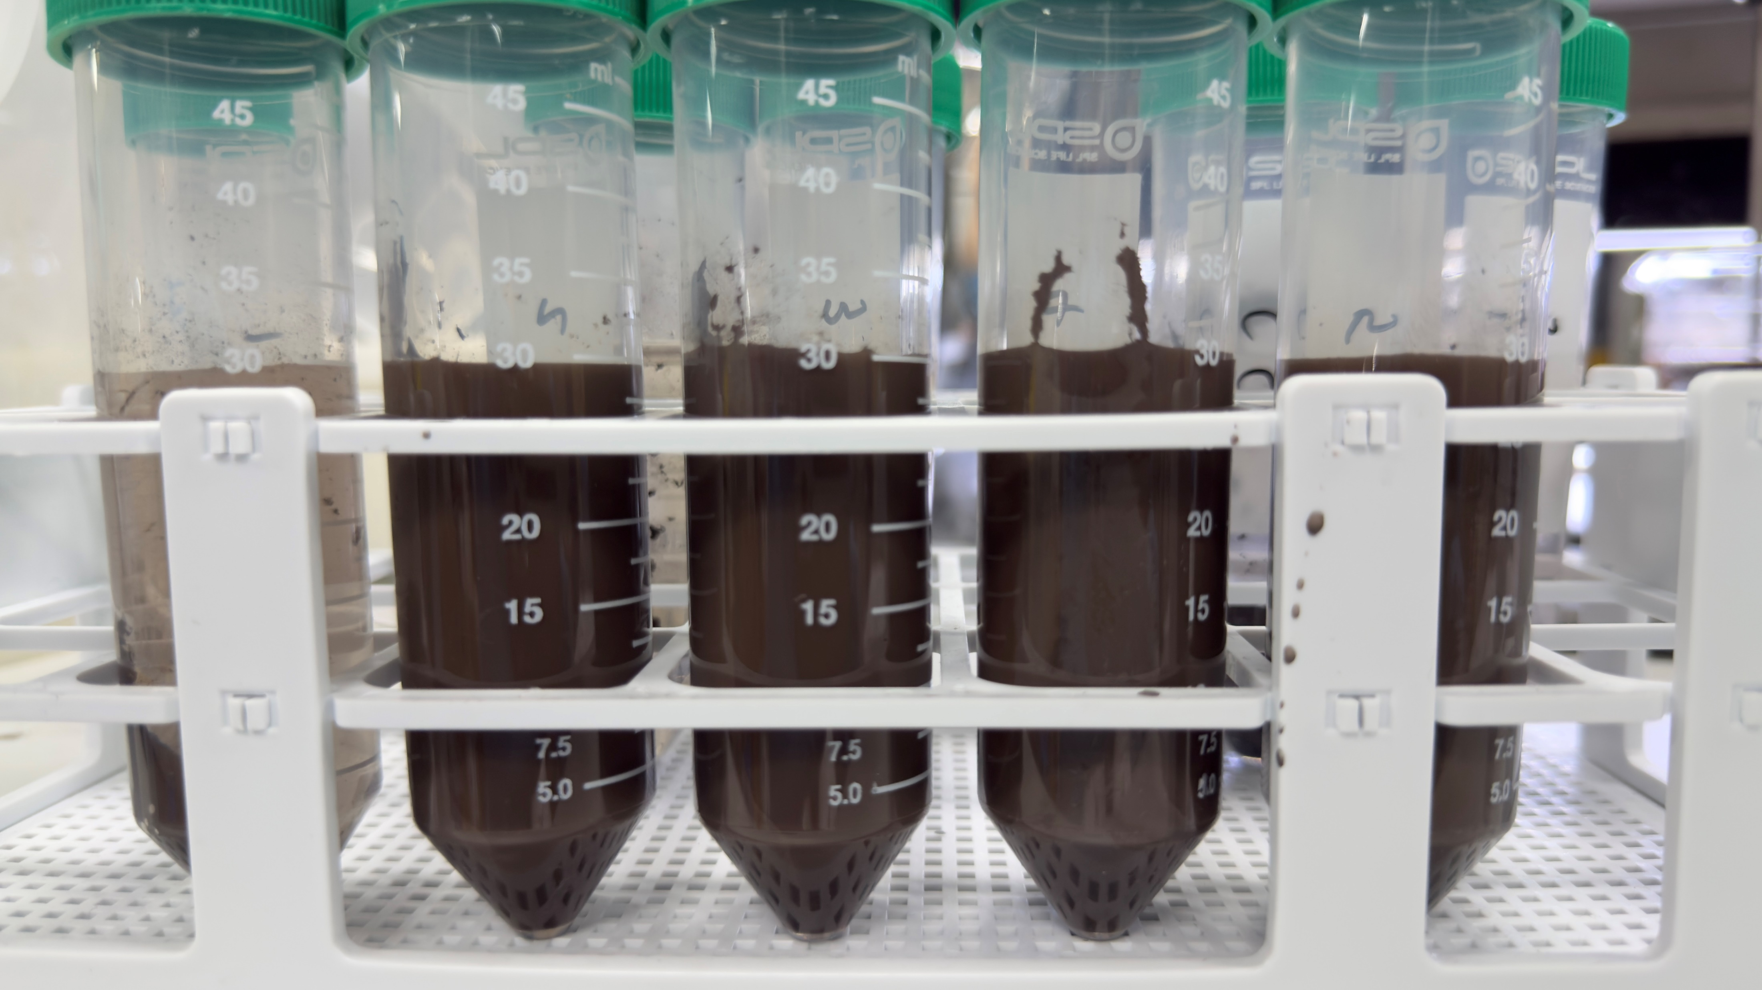
Results
Aquafloc 1035
Kimic 448030
Kimic 446520
Kimic 445510
Cationic
Conclusion from this test
Aquafloc 1035 was the most effective cationic polymer

Slide 19
THANK YOU!

